Slide 1
Code Reviews
By: Edgar trujillo

Slide 2


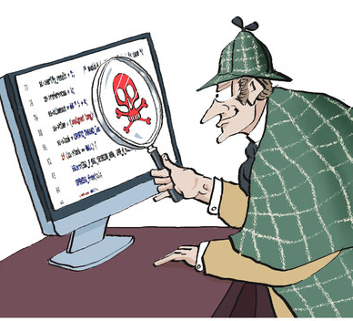
What are code reviews
Code reviews is the act of taking an objective view at code that was produced and ensuring that it meets a certain level of standard
Notes:
State that code reviews can be done by yourself, but are meant to be done with peers to have a different point of view

Slide 3


Where do code reviews take place
They can take place ANYWHERE
Notes:
Code reviews can be either formal or informal and can occur in an office like setting or lounging around.
The goal is to ensure that the code meets certain standards so code reviews can even occur online on places such as Github

Slide 4
What standards are you talking about?
Everyone does code reviews differently and focus on different areas
Some areas they focus on are:
Structure
Documentation
Variables
Arithmetic Operations
Loops and Branches
Defensive Programming
Notes:
It depends on the type of code review you want to conduct. You can make one very structured that reviews these different categories or select a few on focus on those. The flexibility is totally decided upon by the team

Slide 5
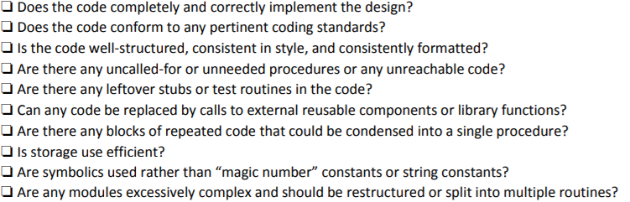
Structure
Notes:
This may be a bigger concern in businesses with a code style and code format rules

Slide 6
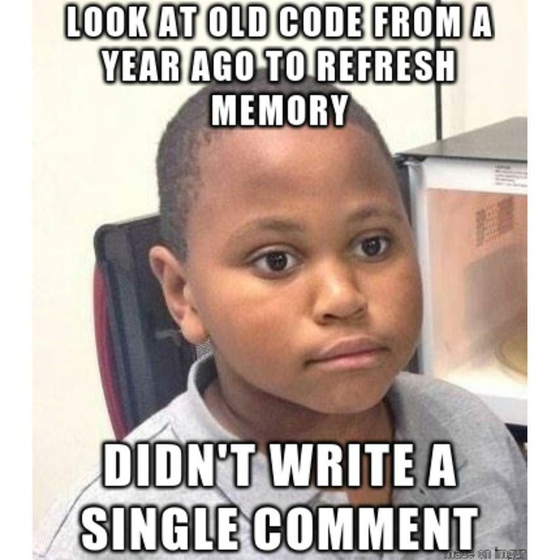
Documentation
Notes:
Writing good comments is not only helpful to you, but also to anyone who will iterate on your code in the future and needs to be able to understand what each function does and why you implemented something in way A vs way B

Slide 7

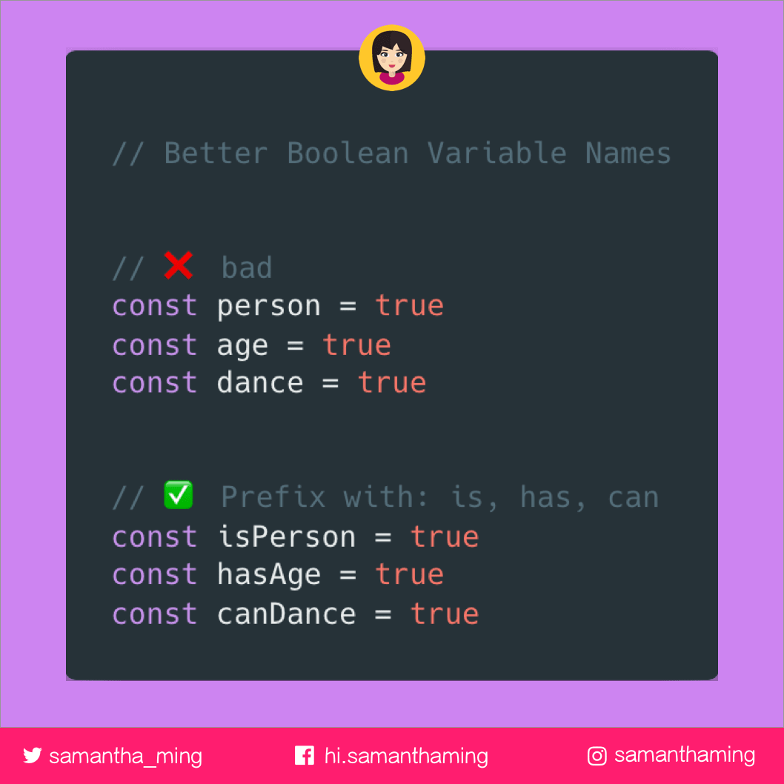
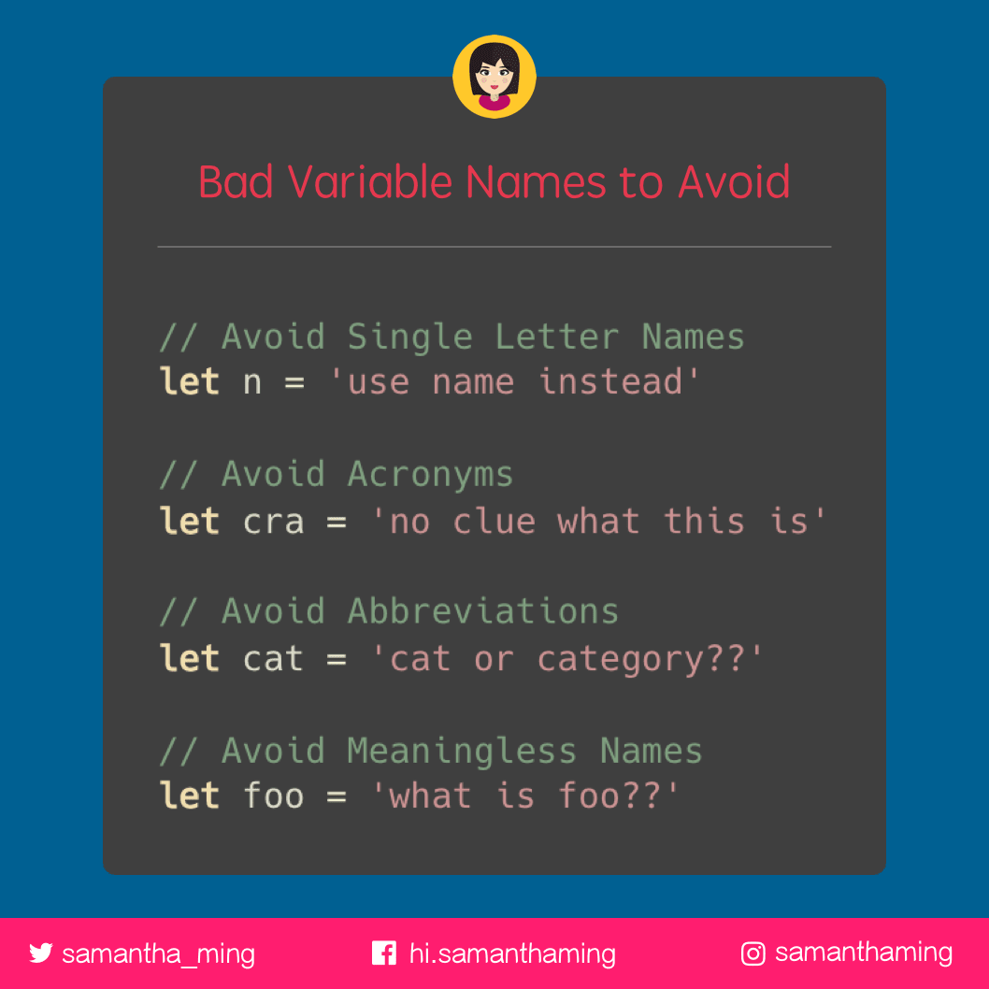
Variables
Notes:
Variables should always be well defined

Slide 8
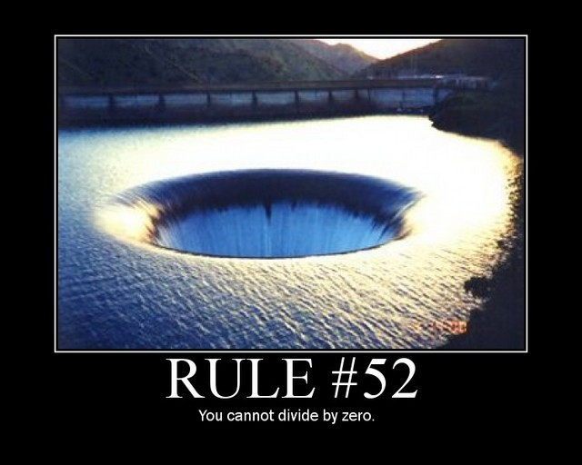
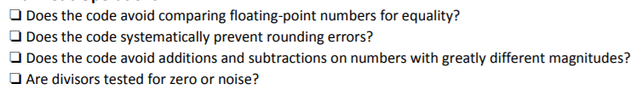
Arithmetic Operations
Notes:
Usually these type of errors can go unnoticed until an input is wrong and crashes everything
This is a good reason why unit tests are created

Slide 9
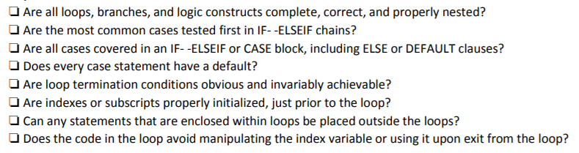
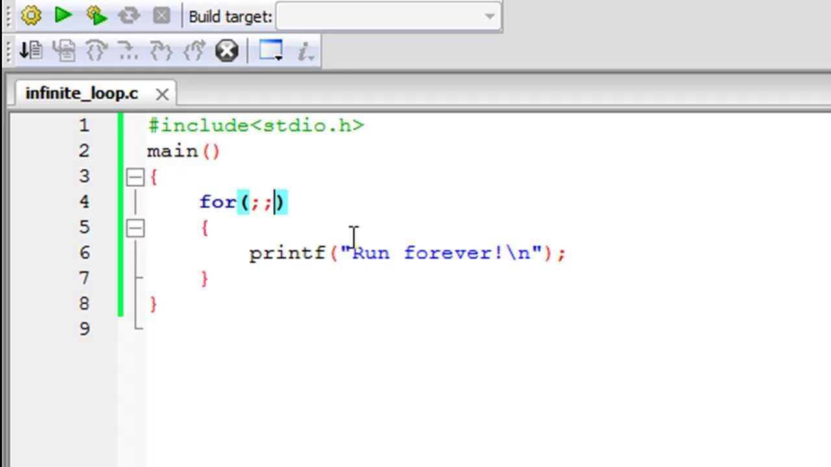
Loops and Branches
Notes:
Always want to make sure your algorithm implementations are error free to prevent crashes

Slide 10
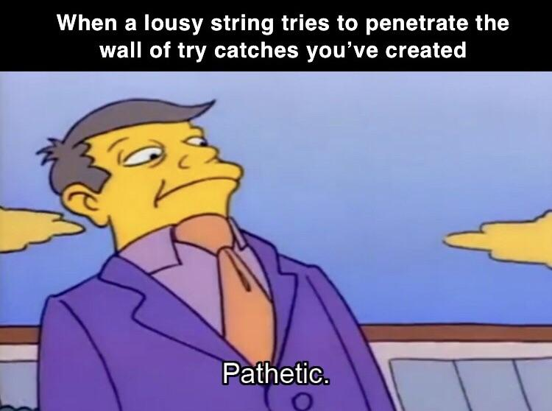
Defensive Programming
Should expect the unexpected
Notes:
Since we never know how users will use the product, we should always try to be ready for anything

Slide 11
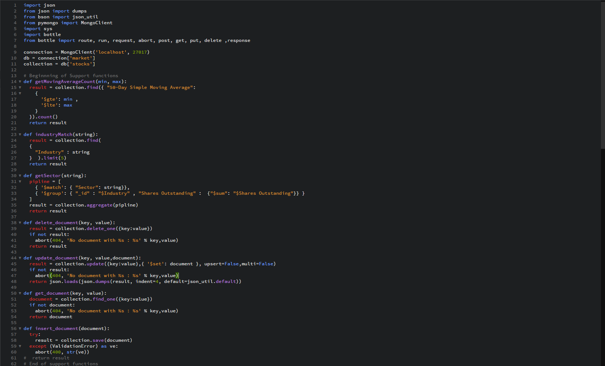
MY Code Part 1

Slide 12
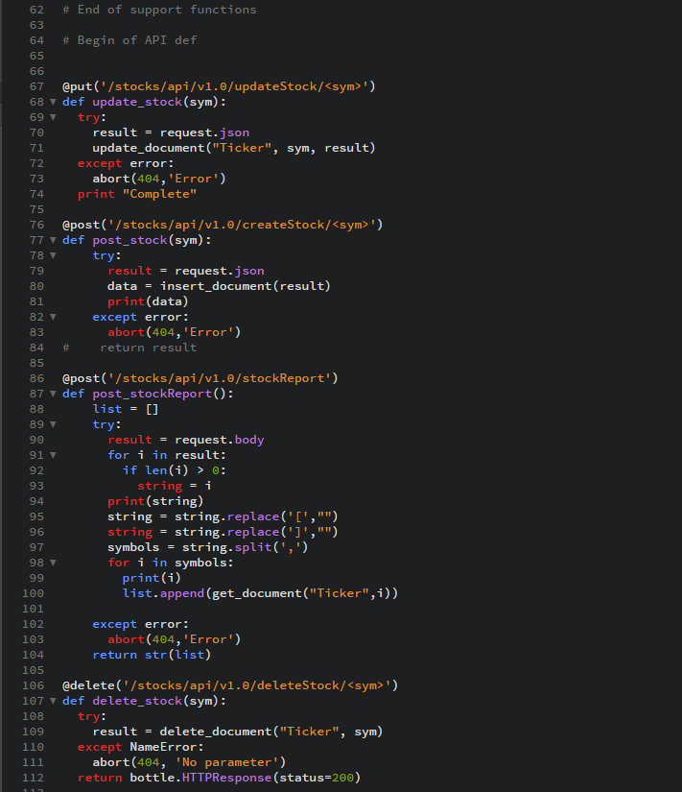
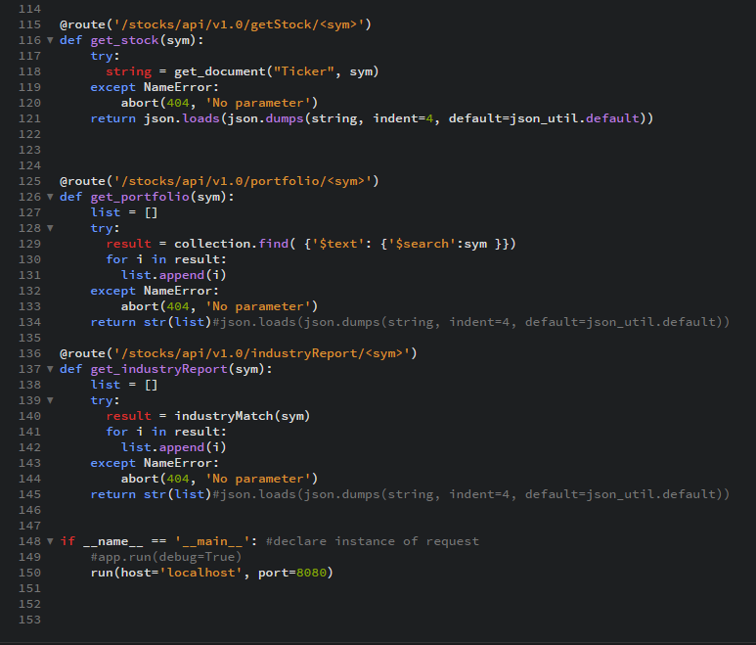
My Code – Part 2

Slide 13
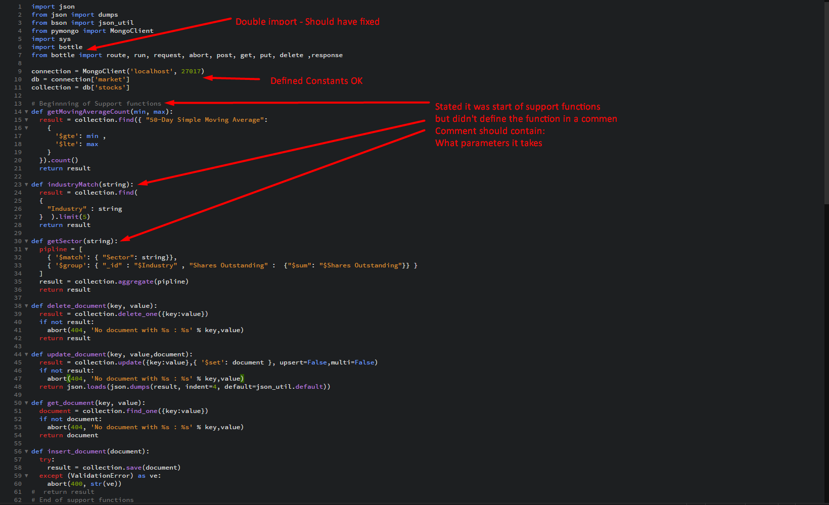
Possible improvements
Notes:
In the enhancements for my artifacts, I can improve the number of comments made and the quality of comments as well

Slide 14
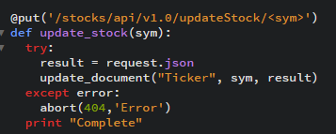
Defensive Programming Example
Notes:
Made sure the code was inserted inside a try/catch block to expect the unexpected

Slide 15
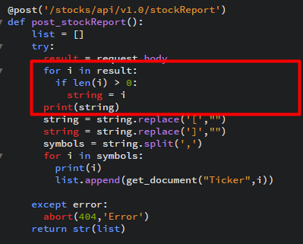
Loops Example

Slide 16

Proper Arithmetic Operation

Slide 17
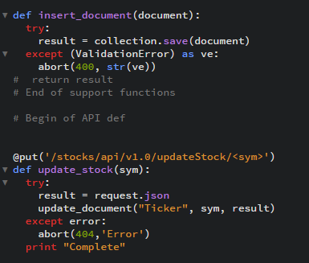
Structure Example
Defined support functions area and start of API definition
Notes:
Helps with the organization of the code

